Slide 1
SOKOINTEL / RESEARCH EXPLAINED
Satellites, Thematic Exposure and Concentration
An educational US-market portfolio, funded and maintained through an explicit policy rather than a prediction of the next winning fund.
USMPC-06 • Dated source record • fictional calculations are labelled as illustrations
Notes:
EPISODE USMPC-06: Satellites, Thematic Exposure and Concentration
ARTICLE: https://sokointel.com/read/usmpc-06/
RESEARCH SNAPSHOT: 10 September 2026
OPENING NARRATION
An educational US-market portfolio, funded and maintained through an explicit policy rather than a prediction of the next winning fund.
Dated source record • fictional calculations are labelled as illustrations
Introduce the decision before defining the technical terms.
ARTICLE SECTION: # Part 06: Satellites, Thematic Exposure and Concentration
US Markets and Portfolio Construction, unified nine-part series. Research edition: 15 September 2026.
Thematic exposures can be useful only when their economic rationale, overlap and loss budget are visible. Semiconductor funds provide a demanding test case.
ARTICLE SECTION: Series scope
A practical research question is whether a semiconductor ETF can offer the low-cost characteristics associated with broad building blocks such as SPYM and QQQM without concealing a different concentration profile. SOXQ is a natural candidate because its stated expense ratio is lower than several larger semiconductor funds. That observation is useful but incomplete. A sector ETF is not selected by price alone. Its index methodology determines what the investor owns, how concentrated the exposure becomes, and how the sleeve interacts with the broad U.S. core established earlier in this series.
As of September 2026, Invesco reports a 0.19% total expense ratio for SOXQ [1]. BlackRock reports 0.33% for SOXX [2]. VanEck reports 0.35% for SMH [3], and State Street reports 0.35% for XSD [4]. Those differences are verifiable. But the funds track different semiconductor indexes, use different weighting rules and hold different numbers of securities. A 16-basis-point fee advantage cannot be evaluated separately from those design choices.
This article therefore reframes the decision as: What semiconductor exposure is the portfolio trying to buy, and which ETF delivers that exposure with acceptable concentration, cost, liquidity and overlap? The calculations are educational examples rather than return forecasts.
Presentation assembled 25 September 2026. Educational source snapshot; no recording or publication is implied.

Slide 2
THE DECISION
The questions and the language
TERMS & UNITS
Satellite weight — fraction of total portfolio capital
Stress return — assumed sleeve return in the scenario
Loss contribution — weight × stress return
Percentage point — additive impact on portfolio return
Thesis break — evidence that invalidates the sleeve rationale
SOKOINTEL / USMPC-06
Source material and recording notes included
02
Notes:
EPISODE USMPC-06: Satellites, Thematic Exposure and Concentration
ARTICLE: https://sokointel.com/read/usmpc-06/
RESEARCH SNAPSHOT: 10 September 2026
Read the questions naturally and define terms in context.
Satellite weight — fraction of total portfolio capital
Stress return — assumed sleeve return in the scenario
Loss contribution — weight × stress return
Percentage point — additive impact on portfolio return
Thesis break — evidence that invalidates the sleeve rationale
Research question mapping:
Presentation assembled 25 September 2026. Educational source snapshot; no recording or publication is implied.

Slide 3
FOLLOW THE MECHANISM
Semiconductors are a concentrated industry exposure
01
SOXQ, SOXX, SMH and XSD use different eligibility and weighting rules.
02
Foundry, design, equipment and memory businesses have different drivers.
03
A low expense ratio does not remove cyclical or geopolitical risk.
Dated source record • fictional calculations are labelled as illustrations
SOKOINTEL / USMPC-06
Source material and recording notes included
03
Notes:
EPISODE USMPC-06: Satellites, Thematic Exposure and Concentration
ARTICLE: https://sokointel.com/read/usmpc-06/
RESEARCH SNAPSHOT: 10 September 2026
Explain the mechanism with the cited article section, then relate it to the opening decision.
Narration: explain each step and its consequence for the opening decision.
ARTICLE SECTION: 4. SOXX: a different benchmark with a larger trading ecosystem
SOXX is the iShares Semiconductor ETF. BlackRock’s current product page reports an expense ratio of 0.33% and identifies its benchmark as the NYSE Semiconductor Index [2]. The fund is one of the largest dedicated semiconductor ETFs and trades with substantial volume, which can matter to investors who use options or execute larger tactical positions.
The critical point is that SOXX does not simply charge more for the exact same portfolio as SOXQ. It follows a different index. Differences in eligibility, weighting, capping, reconstitution and constituent definitions can create different exposures and tracking paths.
For a buy-and-hold investor making small periodic purchases, a 14-basis-point annual fee difference versus SOXQ is meaningful over long horizons. For a trader who values spreads, depth or derivative liquidity, total implementation cost may point in another direction. The correct comparison therefore includes both holding cost and trading utility.
BlackRock also announced a forward stock split for SOXX in 2026 [2]. A split changes share count and nominal share price, not the economic value of the position. It is therefore not a reason by itself to prefer or avoid the fund. This is a useful example of filtering economically irrelevant headlines from portfolio decisions.
ARTICLE SECTION: 3. SOXQ: low cost, concentrated benchmark
Invesco states that SOXQ tracks the PHLX Semiconductor Sector Index and generally invests at least 90% of total assets in securities comprising that index [1]. The fund’s current expense ratio is 0.19%. Invesco describes the underlying index as including 30 of the largest U.S.-listed companies engaged in the semiconductor business, with scheduled reconstitution and rebalancing [1].
Nasdaq’s index overview describes the PHLX Semiconductor Sector Index (SOX) as a modified market-cap-weighted index of 30 semiconductor companies involved in design, distribution, manufacture and sale [8]. The key phrase is modified market-cap weighted. SOXQ is not equal-weighted, and it is not automatically a broad representation of every company in the semiconductor ecosystem.
SOXQ’s strengths for a long-horizon investor are straightforward:
- currently the lowest stated expense ratio among the four funds reviewed here;
- a transparent, established 30-company benchmark;
- straightforward sector purity; and
- an index structure that gives larger businesses larger influence, subject to index methodology.
Its limitations follow from the same design. Thirty holdings is not a large universe. Modified market-cap weighting can produce significant exposure to the largest constituents. The fund is therefore a concentrated sector bet even if no single stock appears extreme in isolation.
Presentation assembled 25 September 2026. Educational source snapshot; no recording or publication is implied.

Slide 4
FOLLOW THE MECHANISM
The satellite overlaps the core
01
Aggregate company exposures across broad and thematic funds.
02
Weight concentration changes the impact of a single-company loss.
03
Test the semiconductor sleeve with growth and market exposures together.
Dated source record • fictional calculations are labelled as illustrations
SOKOINTEL / USMPC-06
Source material and recording notes included
04
Notes:
EPISODE USMPC-06: Satellites, Thematic Exposure and Concentration
ARTICLE: https://sokointel.com/read/usmpc-06/
RESEARCH SNAPSHOT: 10 September 2026
Explain the mechanism with the cited article section, then relate it to the opening decision.
Narration: explain each step and its consequence for the opening decision.
ARTICLE SECTION: 1. Why a semiconductor ETF belongs in the satellite, not the core
Semiconductors sit upstream of a remarkable range of economic activity: cloud computing, artificial intelligence, automobiles, communications equipment, industrial automation, consumer devices and data centers. That makes the industry strategically important, but importance is not the same as diversification.
A broad S&P 500 ETF already owns major semiconductor companies. A Nasdaq-100 ETF also holds many large chip and semiconductor-equipment firms when they meet index eligibility. Adding a semiconductor ETF therefore overweights an industry already embedded in the core. It should be described as a sector tilt.
This distinction matters because concentration changes the portfolio’s failure modes. A sector sleeve can outperform strongly when earnings, capital spending and valuations move in its favor, yet suffer sharper drawdowns when the semiconductor cycle turns. State Street explicitly warns that sector-focused funds can be more volatile than broadly diversified funds [4]. Invesco likewise notes that SOXQ is non-diversified and that concentration in a specific industry can increase risk [1].
In portfolio language, the semiconductor allocation is not a separate asset class. It is a high-beta, high-conviction equity satellite layered onto existing U.S. equity beta.
ARTICLE SECTION: # Part 06: Satellites, Thematic Exposure and Concentration
US Markets and Portfolio Construction, unified nine-part series. Research edition: 15 September 2026.
Thematic exposures can be useful only when their economic rationale, overlap and loss budget are visible. Semiconductor funds provide a demanding test case.
Presentation assembled 25 September 2026. Educational source snapshot; no recording or publication is implied.

Slide 5
FOLLOW THE MECHANISM
Choose a loss budget before a theme
01
Size the sleeve using a plausible stress loss.
02
Set a target band and a thesis-break condition.
03
Record the evidence that would reduce, retain or exit the position.
Dated source record • fictional calculations are labelled as illustrations
SOKOINTEL / USMPC-06
Source material and recording notes included
05
Notes:
EPISODE USMPC-06: Satellites, Thematic Exposure and Concentration
ARTICLE: https://sokointel.com/read/usmpc-06/
RESEARCH SNAPSHOT: 10 September 2026
Explain the mechanism with the cited article section, then relate it to the opening decision.
Narration: explain each step and its consequence for the opening decision.
ARTICLE SECTION: Calculation table 3: satellite loss budget
| Maximum allowed portfolio impact | Assumed semiconductor drawdown | Maximum satellite weight |
|---:|---:|---:|
| 2.5% | -50% | 5% |
| 5.0% | -50% | 10% |
| 7.5% | -50% | 15% |
| 5.0% | -40% | 12.5% |
| 5.0% | -60% | 8.3% |
This method does not predict the next drawdown. It asks whether the portfolio remains survivable if a plausible severe scenario occurs.
ARTICLE SECTION: 17. Rebalancing a volatile satellite
A sector sleeve should have a target and a band. If the policy target is 10% and the allowed range is 8%–12%, a strong rally that lifts the sleeve to 14% triggers a rebalance under a threshold policy. A severe decline that reduces it to 7% triggers a review and potentially a purchase, but only if the strategic thesis remains intact.
The distinction between rebalancing and averaging down is governance. Rebalancing follows a pre-written policy. Averaging down can be an improvised response to loss. If fundamentals or benchmark methodology change enough to invalidate the thesis, the correct action may be to change the policy rather than mechanically restore the old weight.
Contribution-first rebalancing can reduce turnover: direct new cash to underweight sleeves before selling overweight funds. The workbook calculates target gaps and shows both full-trade and contribution-first paths.
Presentation assembled 25 September 2026. Educational source snapshot; no recording or publication is implied.

Slide 6
THE RELATIONSHIP
Size the satellite against a stress loss
Portfolio loss contribution ≈ sleeve weight × sleeve loss
Illustration: 15% sleeve × −40% sleeve return = −6 percentage points.
Other sleeves can fall at the same time. This isolates one contribution, not the full stress outcome.
Dated source record • fictional calculations are labelled as illustrations
SOKOINTEL / USMPC-06
Source material and recording notes included
06
Notes:
EPISODE USMPC-06: Satellites, Thematic Exposure and Concentration
ARTICLE: https://sokointel.com/read/usmpc-06/
RESEARCH SNAPSHOT: 10 September 2026
Article worked example and saved workbook evidence; preserve their separate assumptions.
Equation: Portfolio loss contribution ≈ sleeve weight × sleeve loss
Substitution: Illustration: 15% sleeve × −40% sleeve return = −6 percentage points.
Interpretation: Other sleeves can fall at the same time. This isolates one contribution, not the full stress outcome.
ARTICLE SECTION: 12. Stress testing the satellite weight
Instead of choosing 10% because round numbers feel sensible, derive a ceiling from loss tolerance. Let \(L_p\) be the maximum portfolio loss the investor is willing to attribute to the semiconductor satellite in a severe sector drawdown and \(D_s\) be the assumed satellite drawdown.
\[
w_s=\frac{L_p}{|D_s|}.
\]
If the maximum acceptable portfolio damage is 5% and the stress assumes the semiconductor ETF falls 50%, the maximum satellite weight is 10%.
ARTICLE SECTION: Calculation table 3: satellite loss budget
| Maximum allowed portfolio impact | Assumed semiconductor drawdown | Maximum satellite weight |
|---:|---:|---:|
| 2.5% | -50% | 5% |
| 5.0% | -50% | 10% |
| 7.5% | -50% | 15% |
| 5.0% | -40% | 12.5% |
| 5.0% | -60% | 8.3% |
This method does not predict the next drawdown. It asks whether the portfolio remains survivable if a plausible severe scenario occurs.
Presentation assembled 25 September 2026. Educational source snapshot; no recording or publication is implied.

Slide 7
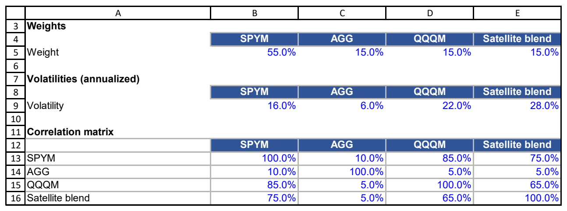
WORKBOOK EVIDENCE
P06 Portfolio Risk: follow the saved workbook
P06 Portfolio Risk!A3:E16
Dated source record • fictional calculations are labelled as illustrations
SOKOINTEL / USMPC-06
Source material and recording notes included
07
Notes:
EPISODE USMPC-06: Satellites, Thematic Exposure and Concentration
ARTICLE: https://sokointel.com/read/usmpc-06/
RESEARCH SNAPSHOT: 10 September 2026
ACTUAL WORKBOOK CAPTURE
Workbook: C:\Users\Nevo\Downloads\financial material\US Markets and Portfolio Construction\US_Markets_Portfolio_Construction_Final_Workbook.xlsx
Sheet/range: 'P06 Portfolio Risk'!A3:E16
SHA-256: 5a040bdadf9c5682f5370a882c44aec18bb6359ea96bcd8121b634d35620ab38
Capture method: Microsoft Excel read-only PDF range export. Print headings retained. Source not saved.
Asset: Evidence/Workbooks/USMPC-06-01-p1.png
SCREEN RECORDING WALKTHROUGH
Read the row and column headings. Identify inputs, follow the dependent row and explain the units. Do not alter the source workbook while recording; use a copy for a new scenario.
Extracted evidence text:
3
4
5
6
7
8
9
10
11
12
13
14
15
16
A B C D E
Weights
SPYM AGG QQQM Satellite blend
Weight 55.0% 15.0% 15.0% 15.0%
Volatilities (annualized)
SPYM AGG QQQM Satellite blend
Volatility 16.0% 6.0% 22.0% 28.0%
Correlation matrix
SPYM AGG QQQM Satellite blend
SPYM 100.0% 10.0% 85.0% 75.0%
AGG 10.0% 100.0% 5.0% 5.0%
QQQM 85.0% 5.0% 100.0% 65.0%
Satellite blend 75.0% 5.0% 65.0% 100.0%
Relevant article context:
ARTICLE SECTION: 11. Sector risk is more than volatility
Volatility is useful but incomplete. Semiconductor satellites can be exposed to several non-independent risks:
Demand-cycle risk. End-market demand can weaken rapidly after periods of shortage or over-ordering.
Capital-intensity risk. Fabrication capacity requires enormous investment and long lead times.
Technology-transition risk. Competitive advantage can change when process nodes, architectures, accelerators or memory technologies shift.
Customer concentration. Some companies depend heavily on a few major buyers or hyperscalers.
Geopolitical and supply-chain risk. Advanced semiconductor supply chains span design software, equipment, foundries, memory, packaging and critical materials across jurisdictions.
Valuation risk. A strong secular growth story can still produce poor investment returns if the starting valuation embeds even stronger expectations.
A sector ETF reduces company-specific failure risk but cannot remove the industry’s shared economic risks.
ARTICLE SECTION: A.1 Weighted portfolio fee
For ETF weights \(w_i\) and expense ratios \(e_i\):
\[
e_p=\sum_i w_ie_i.
\]
A 10% SOXQ sleeve contributes approximately \(0.10\times0.19\%=0.019\%\) to total portfolio expense. A 10% XSD sleeve contributes approximately 0.035%. The 0.016 percentage-point portfolio difference equals $16 per year per $100,000 of total portfolio value before compounding.
Presentation assembled 25 September 2026. Educational source snapshot; no recording or publication is implied.

Slide 8
CHANGE THE ASSUMPTION
Test the satellite without promising a loss limit
BASE / STARTING RECORD
CHANGED CASE / NEW EVIDENCE
15% satellite; illustrative −40% sleeve shock.
Increase the weight to 20%, retaining the same shock.
Loss contribution rises from −6 to −8 percentage points; correlations can add wider portfolio losses.
Sensitivity or evidence comparison; interpretation depends on the stated assumptions.
SOKOINTEL / USMPC-06
Source material and recording notes included
08
Notes:
EPISODE USMPC-06: Satellites, Thematic Exposure and Concentration
ARTICLE: https://sokointel.com/read/usmpc-06/
RESEARCH SNAPSHOT: 10 September 2026
Teaching sensitivity; hold other assumptions fixed unless a multi-input case is explicitly named.
Base: 15% satellite; illustrative −40% sleeve shock.
Changed: Increase the weight to 20%, retaining the same shock.
Consequence: Loss contribution rises from −6 to −8 percentage points; correlations can add wider portfolio losses.
ARTICLE SECTION: 12. Stress testing the satellite weight
Instead of choosing 10% because round numbers feel sensible, derive a ceiling from loss tolerance. Let \(L_p\) be the maximum portfolio loss the investor is willing to attribute to the semiconductor satellite in a severe sector drawdown and \(D_s\) be the assumed satellite drawdown.
\[
w_s=\frac{L_p}{|D_s|}.
\]
If the maximum acceptable portfolio damage is 5% and the stress assumes the semiconductor ETF falls 50%, the maximum satellite weight is 10%.
ARTICLE SECTION: Calculation table 3: satellite loss budget
| Maximum allowed portfolio impact | Assumed semiconductor drawdown | Maximum satellite weight |
|---:|---:|---:|
| 2.5% | -50% | 5% |
| 5.0% | -50% | 10% |
| 7.5% | -50% | 15% |
| 5.0% | -40% | 12.5% |
| 5.0% | -60% | 8.3% |
This method does not predict the next drawdown. It asks whether the portfolio remains survivable if a plausible severe scenario occurs.
Presentation assembled 25 September 2026. Educational source snapshot; no recording or publication is implied.

Slide 9
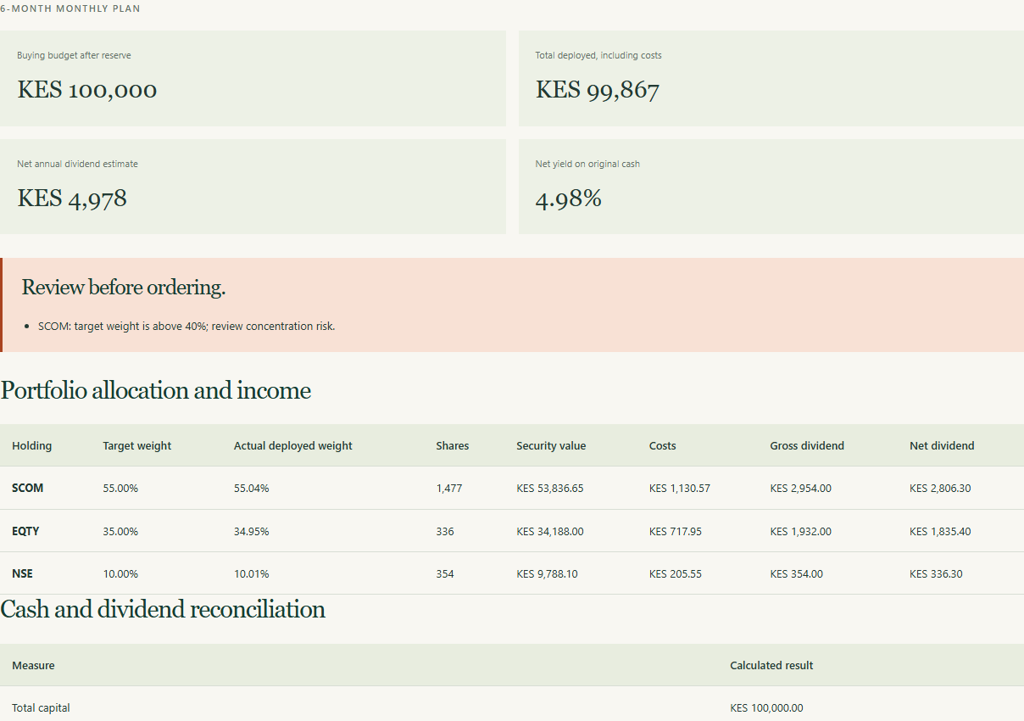
SAVED WEB DEMONSTRATION
A focused calculator demonstration
WHAT THIS TOOL DOES
Use target weights, reference prices and costs to form an affordable purchase plan. Follow the residual cash after integer-share rounding.
Stress losses, covariance and HHI belong in the workbook, not this purchase planner.
Saved production page • /calculators/dca-portfolio/ • captured 2026-09-25
SOKOINTEL / USMPC-06
Source material and recording notes included
09
Notes:
EPISODE USMPC-06: Satellites, Thematic Exposure and Concentration
ARTICLE: https://sokointel.com/read/usmpc-06/
RESEARCH SNAPSHOT: 10 September 2026
REAL WEB CAPTURE
{
"slug": "dca-portfolio",
"url": "https://sokointel.com/calculators/dca-portfolio/",
"captured_at": "2026-09-25T05:01:21.691Z",
"inputs": [
{
"name": "total_cash",
"value": "100000"
},
{
"name": "deployment_months",
"value": "6"
},
{
"name": "percentage_commission",
"value": "2.1"
},
{
"name": "fixed_order_fee",
"value": "0"
},
{
"name": "minimum_order_fee",
"value": "0"
},
{
"name": "cash_reserve",
"value": "0"
},
{
"name": "default_withholding_tax",
"value": "5"
},
{
"name": "purchase_mode",
"value": "monthly"
},
{
"name": "holding_label_0",
"value": "SCOM"
},
{
"name": "holding_share_price_0",
"value": "36.45"
},
{
"name": "holding_target_weight_0",
"value": "55"
},
{
"name": "holding_dividend_per_share_0",
"value": "2"
},
{
"name": "holding_withholding_tax_0",
"value": ""
},
{
"name": "holding_sector_0",
"value": ""
},
{
"name": "holding_label_1",
"value": "EQTY"
},
{
"name": "holding_share_price_1",
"value": "101.75"
},
{
"name": "holding_target_weight_1",
"value": "35"
},
{
"name": "holding_dividend_per_share_1",
"value": "5.75"
},
{
"name": "holding_withholding_tax_1",
"value": ""
},
{
"name": "holding_sector_1",
"value": ""
},
{
"name": "holding_label_2",
"value": "NSE"
},
{
"name": "holding_share_price_2",
"value": "27.65"
},
{
"name": "holding_target_weight_2",
"value": "10"
},
{
"name": "holding_dividend_per_share_2",
"value": "1"
},
{
"name": "holding_withholding_tax_2",
"value": ""
},
{
"name": "holding_sector_2",
"value": ""
}
],
"screenshots": [
"dca-portfolio-inputs.png",
"dca-portfolio-full.png",
"dca-portfolio-results.png",
"dca-portfolio-summary.png"
],
"get_status": 200,
"title": "DCA portfolio and dividend planner | Sokointel",
"scenario": "Illustrative historical-price teaching scenario supplied in the project discussion; not current quotes.",
"post_status": 200,
"results_text": "6-MONTH MONTHLY PLAN\n\nBuying budget after reserve\nKES 100,000\nTotal deployed, including costs\nKES 99,867\nNet annual dividend estimate\nKES 4,978\nNet yield on original cash\n4.98%\nReview before ordering.\nSCOM: target weight is above 40%; review concentration risk.\nPortfolio allocation and income\nHolding\tTarget weight\tActual deployed weight\tShares\tSecurity value\tCosts\tGross dividend\tNet dividend\nSCOM\t55.00%\t55.04%\t1,477\tKES 53,836.65\tKES 1,130.57\tKES 2,954.00\tKES 2,806.30\nEQTY\t35.00%\t34.95%\t336\tKES 34,188.00\tKES 717.95\tKES 1,932.00\tKES 1,835.40\nNSE\t10.00%\t10.01%\t354\tKES 9,788.10\tKES 205.55\tKES 354.00\tKES 336.30\nCash and dividend reconciliation\nMeasure\tCalculated result\nTotal capital\tKES 100,000.00\nCash reserve retained\tKES 0.00\nSecurities purchased\tKES 97,812.75\nTransaction costs\tKES 2,054.07\nUncommitted cash after whole-share rounding\tKES 133.18\nGross annual dividend estimate\tKES 5,240.00\nDividend withholding estimate\tKES 262.00\nNet yield on deployed capital\t4.98%\nSee the monthly purchase schedule\nFollow the calculation\n𝐵\n=\n𝐶\n−\n𝑅\n,\n𝑇\n𝑖\n,\n𝑡\n=\n𝐵\n𝑚\n×\n𝑤\n𝑖\n×\n𝑡\n𝑁\n𝑖\n,\n𝑡\n=\n⌊\n𝐴\n𝑖\n,\n𝑡\n𝑃\n𝑖\n+\ncost per share\n𝑖\n,\n𝑡\n⌋\n,\n𝐷\n𝑖\n,\nnet\n=\n𝑆\n𝑖\n𝑑\n𝑖\n(\n1\n−\n𝜏\n𝑖\n)\nTake the research further.\n\nRead the full NSE dividend-growth case, then use its companion formula workbook for changing prices, dividend growth, reinvestment, rebalancing bands, dividend cuts, sector limits, and scenarios.\n\nRead the DCA research →",
"alerts": [],
"base": "Evidence/Web"
}
DEMONSTRATION SCOPE
Use target weights, reference prices and costs to form an affordable purchase plan. Follow the residual cash after integer-share rounding.
Stress losses, covariance and HHI belong in the workbook, not this purchase planner.
The calculator defaults may be a separate teaching example. Do not claim the displayed default equals the article or workbook case unless inputs and conventions have been reconciled. DCF uses FCFF discounted at WACC, subtracting net debt once; do not put after-interest owner earnings into that model. For financial companies use the separate capital model.
For the DCA dividend capture only: the original page renders a fraction as a percentage without multiplying by 100. The derived screenshot is an exact table crop excluding that card, not a retouched page. Correct yield = 1,015.5093/100,000 ×100 = 1.0155093%, approximately 1.02%. The protected tool was not changed.
The DCA portfolio calculator is limited to purchase/allocation mechanics and does not calculate a 30-company HHI, correlation or a stress loss. The compounding explorer is a constant-return contribution-timing model, not a sequence-of-returns withdrawal simulation.
Presentation assembled 25 September 2026. Educational source snapshot; no recording or publication is implied.

Slide 10
ANSWER THE OPENING QUESTION
What the evidence lets us conclude
A thematic fund adds concentrated industry risk even when it holds multiple companies. Size the position against a portfolio loss budget and explicit thesis conditions.
YOUR NEXT RECORD
Set a satellite target, band and thesis-break condition tied to named evidence.
SOKOINTEL / USMPC-06
Source material and recording notes included
10
Notes:
EPISODE USMPC-06: Satellites, Thematic Exposure and Concentration
ARTICLE: https://sokointel.com/read/usmpc-06/
RESEARCH SNAPSHOT: 10 September 2026
Answer: A thematic fund adds concentrated industry risk even when it holds multiple companies. Size the position against a portfolio loss budget and explicit thesis conditions.
Viewer task: Set a satellite target, band and thesis-break condition tied to named evidence.
Return to each opening research question and identify what remains conditional or unknown.
ARTICLE SECTION: 16. An illustrative allocation decision
Suppose the strategic policy is 60% SPYM, 15% QQQM, 10% semiconductor ETF and 15% tactical/reserve. The semiconductor sleeve has one job: add a bounded industry overweight. It is not expected to provide crash protection, income stability or geographic diversification.
Under that policy, SOXQ can be a reasonable implementation candidate when the investor prioritizes low annual fund expenses and accepts the PHLX index design. XSD may better fit an investor who wants less mega-cap concentration. SMH may better fit an investor who deliberately wants the largest U.S.-listed global semiconductor leaders. SOXX may be attractive when its scale, liquidity or derivative ecosystem materially improves execution.
Notice what is absent from the decision: “Which one returned the most last year?” The answer to that question can change with the measurement window and often rewards whatever concentration happened to win recently.
ARTICLE SECTION: 4. SOXX: a different benchmark with a larger trading ecosystem
SOXX is the iShares Semiconductor ETF. BlackRock’s current product page reports an expense ratio of 0.33% and identifies its benchmark as the NYSE Semiconductor Index [2]. The fund is one of the largest dedicated semiconductor ETFs and trades with substantial volume, which can matter to investors who use options or execute larger tactical positions.
The critical point is that SOXX does not simply charge more for the exact same portfolio as SOXQ. It follows a different index. Differences in eligibility, weighting, capping, reconstitution and constituent definitions can create different exposures and tracking paths.
For a buy-and-hold investor making small periodic purchases, a 14-basis-point annual fee difference versus SOXQ is meaningful over long horizons. For a trader who values spreads, depth or derivative liquidity, total implementation cost may point in another direction. The correct comparison therefore includes both holding cost and trading utility.
BlackRock also announced a forward stock split for SOXX in 2026 [2]. A split changes share count and nominal share price, not the economic value of the position. It is therefore not a reason by itself to prefer or avoid the fund. This is a useful example of filtering economically irrelevant headlines from portfolio decisions.
Presentation assembled 25 September 2026. Educational source snapshot; no recording or publication is implied.

Slide 11
SOURCE RECORD
Sources, dates and companion material
Read the episode: sokointel.com/read/usmpc-06/
1. Source article: Satellites, Thematic Exposure and Concentration
2. Companion workbook: US_Markets_Portfolio_Construction_Final_Workbook
3. Exact source ranges: 'P06 Portfolio Risk'!A3:E16
4. Source dates and assumptions: retain the period labels in the article and captured workbook; full provenance in notes.
Full source references, workbook paths, cell ranges and capture metadata are preserved in speaker notes and the episode manifest.
SOKOINTEL / USMPC-06
Source material and recording notes included
11
Notes:
EPISODE USMPC-06: Satellites, Thematic Exposure and Concentration
ARTICLE: https://sokointel.com/read/usmpc-06/
RESEARCH SNAPSHOT: 10 September 2026
SOURCE MATERIAL
All linked source URLs:
Additional content sources:
[]
Workbook provenance:
C:\Users\Nevo\Downloads\financial material\US Markets and Portfolio Construction\US_Markets_Portfolio_Construction_Final_Workbook.xlsx
'P06 Portfolio Risk'!A3:E16
5a040bdadf9c5682f5370a882c44aec18bb6359ea96bcd8121b634d35620ab38
Article catalog snapshot hash: e4605210b04811ea848b3d4bef140d9caaeb16174d1488e3d29f8d71eb6a9f45
Presentation assembled 25 September 2026. Educational source snapshot; no recording or publication is implied.

